Slide 1

Reverse Engineering
with angr and z3
Play with zeros and ones
Rakesh Kumar

Slide 2

Content
$Whoami
What is reverse engineering?
Process of compilation.
Disassemble, Decompile and Debug.
Static and Dynamic Analysis.
Tools.
Angr.
Z3.
Live Demo

Slide 3

<< WHOAMI >>
Rakesh Kumar ( 0xrakesh )
Computer science student
CTF Player
TamilCTF Member
Interested in reverse engineering and cryptography
Social Media
http://0xrakesh.github.io
0xrakesh @GITHUB
0xcyberhackz @TWITTER

Slide 4
What is reverse engineering
Reverse engineering is the process of analyzing the program’s function and structure.
Reverse engineering play a major role in malware analysis.

Slide 5
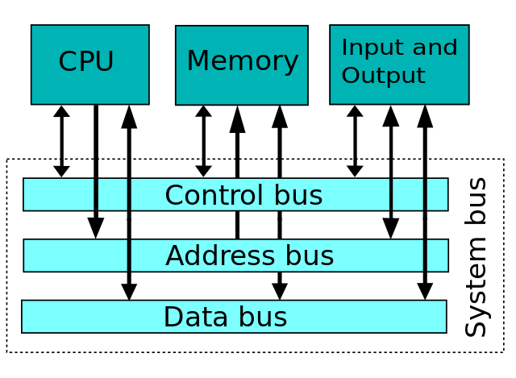
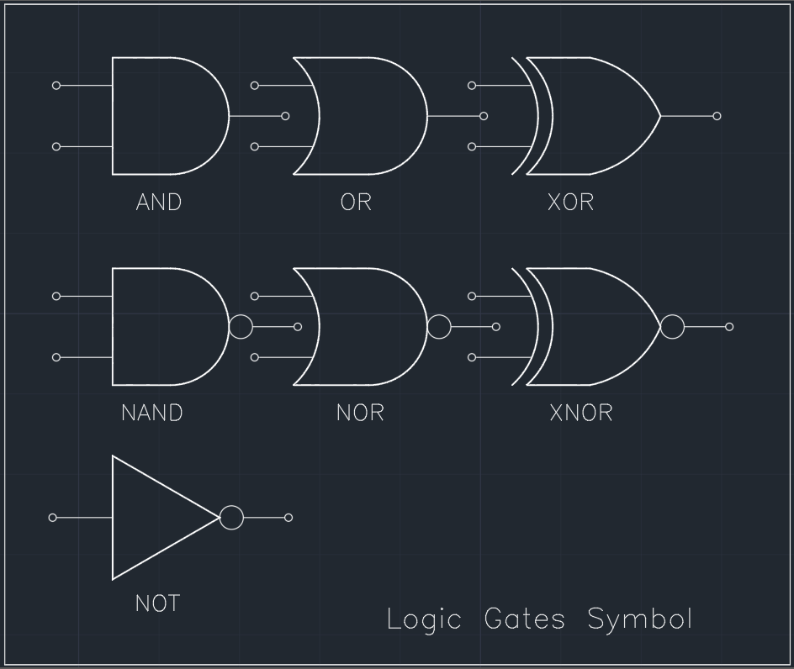
How CPU work
A CPU executes an instruction by fetching it from memory, using its ALU to perform an operation, and then storing the result to memory.
The actual mathematical operation for each instruction is performed by a combinational logic circuit within the CPU's processor known as the arithmetic–logic unit or ALU

Slide 6
CPU Registers
General Purpose Register : EAX, EBX, ECX, EDX, ESP, EBP, EDI, ESI
Special Purpose Register: EIP, Program Counter
Assembly Instruction
mov eax, 4
mov ecx, 2
add eax, ecx
sub eax, ecx
A = 4
B = 2
A+B
A-B

Slide 7
Compilation Process:
Source Code
Preprocessor
Compiler
Assembler
Linker
Executable file

Slide 8
Decompiler
Disassembler
Decompiling is the process of translating the object code or compiled code to source code.
(Low-Level Code -> High Level Code )
Disassemble is the process of translating the object code or compiled code to assembly code.
(Low-Level Code -> Assembly Code )

Slide 9
Debug
Debugging is the process of finding and removing errors from the program.
In simple words, tracing the program.

Slide 10
Reverse Engineering
Reverse engineering is the process of analyzing the program.
There are two types of analysis:
1. Static Analysis.
2. Dynamic Analysis.
Static Analysis: Analyze the program without actually executing it.
In other words analyze the program’s structure.
Dynamic Analysis: Analyze the program’s behavior by executing it.

Slide 11
Basic tools
file
strings
ltrace
Objdump
Gdb
Ghidra
IDA
Binary Ninja
WinDbg
DNSpy

Slide 12
Demo

Slide 13
ANGR
Angr is a python framework for analysis binary.
Angr is a multi-architecture binary analysis toolset.
Analyzes both static and dynamic binary.
USES
Disassembly.
Symbolic execution.
Control-flow analysis.
Decompilation.

Slide 14
Let’s analysis the binary with angr

Slide 15
Angr
angr.Project(‘filename’) -> Open the binary
project.arch -> Display the arch of the binary
project.entry -> Display the entry address

Slide 16
Loader
Loader is represent the binary in virtual address space
project.loader -> Display the entire memory address of binary (libc)
project.loader.main_object -> Display the program function memory address.
project.loader.shared_objects -> Display the memory address of shared objects
project.loader.find_symbol(‘func’) -> Display the memory address of the function.
proj.loader.main_object.execstack -> Check the stack is executable.
proj.loader.main_object.pic -> Check if the binary is position independent
proj.loader.main_object.plt[‘func’] -> Display the address of the func in plt.

Slide 17
Factory
project.factory.block(‘main’).pp() -> Disassemble the function
state = project.factory.entry_state() -> Simulation Program State.
state.regs.rip -> Address of instruction pointer.
state.regs.rax -> Address of rax register.

Slide 18
Solve the challenge with angr

Slide 19
Z3 Framework
Z3 is a high-performance theorem prover developed at Microsoft Research.
Z3 is used in many applications like constraint solving, analysis of hybrid systems.
Z3 is based on SMT ( Satisfiability modulo theories )

Slide 20
Structure of Z3 program
from z3 import *
s = Solver()
x = Bool(‘x’) # Init the variable
s.add(x == 4) # Adding Constraint
s.check() # Check the constraint is satify or not
s.model() # Final output

Slide 21
Solve the challenge using z3

Slide 22
Resources
crackmes.one
ctfsites.github.io
challenges.re
Tryhackme : Reversing ELF, Reverse Engineering, Windows RevEng, Brainstorm.
HackTheBox
RESources

Slide 23
Thank you

